Slide 1
Compromises that Ensnare
Encounter Service 27 May 2017
Cecil Ang

Slide 2
1 Kings 3:1-15 ESV
Solomon made a marriage alliance with Pharaoh king of Egypt. He took Pharaoh's daughter and brought her into the city of David until he had finished building his own house and the house of the Lord and the wall around Jerusalem. ² The people were sacrificing at the high places, however, because no house had yet been built for the name of the Lord. ³ Solomon loved the Lord, walking in the statutes of David his father, only he sacrificed and made offerings at the high places. ⁴ And the king went to Gibeon to sacrifice there, for that was the great high place. Solomon used to offer a thousand burnt offerings on that altar. ⁵ At Gibeon the Lord appeared to Solomon in a dream by night, and God said, “Ask what I shall give you.”

Slide 3
1 Kings 3:1-15 ESV
⁶ And Solomon said, “You have shown great and steadfast love to your servant David my father, because he walked before you in faithfulness, in righteousness, and in uprightness of heart toward you. And you have kept for him this great and steadfast love and have given him a son to sit on his throne this day. ⁷ And now, O Lord my God, you have made your servant king in place of David my father, although I am but a little child. I do not know how to go out or come in. ⁸ And your servant is in the midst of your people whom you have chosen, a great people, too many to be numbered or counted for multitude. ⁹ Give your servant therefore an understanding mind to govern your people, that I may discern between good and evil, for who is able to govern this your great people?” ¹⁰ It pleased the Lord that Solomon had asked this.

Slide 4
1 Kings 3:1-15 ESV
¹¹ And God said to him, “Because you have asked this, and have not asked for yourself long life or riches or the life of your enemies, but have asked for yourself understanding to discern what is right, ¹² behold, I now do according to your word. Behold, I give you a wise and discerning mind, so that none like you has been before you and none like you shall arise after you. ¹³ I give you also what you have not asked, both riches and honor, so that no other king shall compare with you, all your days. ¹⁴ And if you will walk in my ways, keeping my statutes and my commandments, as your father David walked, then I will lengthen your days.” ¹⁵ And Solomon awoke, and behold, it was a dream. Then he came to Jerusalem and stood before the ark of the covenant of the Lord, and offered up burnt offerings and peace offerings, and made a feast for all his servants.

Slide 5
Our choices now determine our future
Solomon’s choices have lasting repercussions:
Positive (Spiritual) | Negative (Fleshly)
Requested for an understanding mind (v 9) Riches (bonus) Honour (bonus) | Marrying foreign wives (v 1) Offering sacrifices at the high places (v 3)
“If you will walk in my ways, keeping my statutes and my commandments, as your father David walked, then I will lengthen your days.” (v 14)

Slide 6
1. Marrying foreign wives
Treaties & alliances between monarchs were often consummated through exchange of daughters as wives
Occurred during the reign of pharaoh Siamun, Tanite dynasty; it could have been arranged by David for Solomon as he enjoyed friendly relations with Egypt before his death
Her dowry included yielding Gezer to Solomon (1 Kg 9:16); the marriage song of Ps 45 could have been composed in commemoration of this royal wedding

Slide 7
1. Marrying foreign wives
When the Lord your God brings you into the land that you are entering to take possession of it, and clears away many nations before you, ... You shall make no covenant with them and show no mercy to them. You shall not intermarry with them, giving your daughters to their sons or taking their daughters for your sons, ⁴ for they would turn away your sons from following me, to serve other gods. Then the anger of the Lord would be kindled against you, and he would destroy you quickly. ⁵ But thus shall you deal with them: you shall break down their altars and dash in pieces their pillars and chop down their Asherim and burn their carved images with fire. Deut 7:1-5 ESV

Slide 8
1. Marrying foreign wives
Solomon loved foreign women; he had already married Naamah the Ammonitess whom he had a son named Rehoboam (1 Kg 14:21)
Now King Solomon loved many foreign women, along with the daughter of Pharaoh: Moabite, Ammonite, Edomite, Sidonian, and Hittite women, ² from the nations concerning which the Lord had said to the people of Israel, “You shall not enter into marriage with them, neither shall they with you, for surely they will turn away your heart after their gods.” Solomon clung to these in love. ³ He had 700 wives, who were princesses, and 300 concubines. And his wives turned away his heart. ⁴ For when Solomon was old his wives turned away his heart after other gods, and his heart was not wholly true to the Lord his God, as was the heart of David his father. 1 Kg 11:1-4 ESV

Slide 9
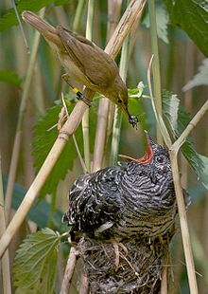
1. Marrying foreign wives
All of us have 2 natures residing within us – the sinful nature and the spiritual nature.
So then, brothers, we are debtors, not to the flesh, to live according to the flesh. For if you live according to the flesh you will die, but if by the Spirit you put to death the deeds of the body, you will live. Rom 8:12-13 ESV
For the one who sows to his own flesh will from the flesh reap corruption, but the one who sows to the Spirit will from the Spirit reap eternal life. Gal 6:8 ESV

Slide 10
1. Marrying foreign wives
Modern day equivalent: to be unequally yoked with unbelievers.
Do not be unequally yoked with unbelievers. For what partnership has righteousness with lawlessness? Or what fellowship has light with darkness? 2 Cor 6:14 ESV
For how do you know, wife, whether you will save your husband? Or how do you know, husband, whether you will save your wife? 1 Cor 7:16 ESV

Slide 11
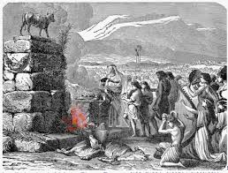
2. Offering sacrifices at the high places
Mentioned 117 times; a high place was a localized or regional worship center (enclosed stepped platform) dedicated to a god. Worship at these local shrines often included making sacrifices, burning incense, and holding feasts or festivals.

Slide 12
2. Offering sacrifices at the high places
There was the temptation for the Israelites to adopt local pagan beliefs and practices. That’s why when the Israelites conquered the Promised Land, they were told to destroy the high places used by the pagan cultures.
“Speak to the people of Israel and say to them, When you pass over the Jordan into the land of Canaan, then you shall drive out all the inhabitants of the land from before you and destroy all their figured stones and destroy all their metal images and demolish all their high places. Num 33:51-52 ESV

Slide 13
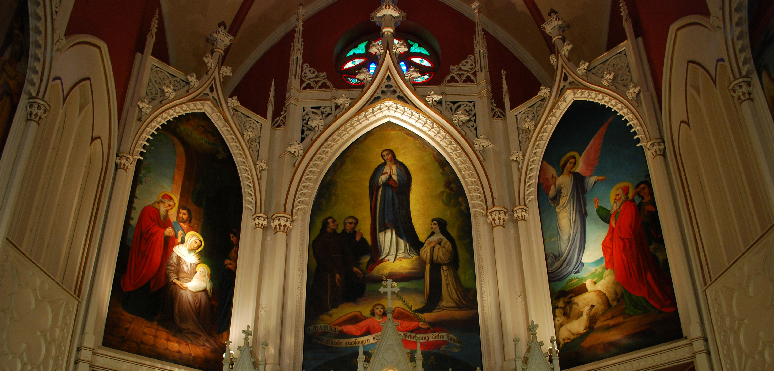
2. Offering sacrifices at the high places
What about today? Some Christians treat Jesus as one of the gods they worship while also worshipping other saints or gods from other cultures.

Slide 14
2. Offering sacrifices at the high places
“You shall have no other gods before me. You shall not make for yourself a carved image, or any likeness of anything that is in heaven above, or that is in the earth beneath, or that is in the water under the earth. You shall not bow down to them or serve them, for I the Lord your God am a jealous God, visiting the iniquity of the fathers on the children to the third and the fourth generation of those who hate me, but showing steadfast love to thousands of those who love me and keep my commandments.” Ex 20:3-6 ESV

Slide 15
2. Offering sacrifices at the high places
Other modern day equivalents: Believers sometimes succumb to today’s “ism-idols” such as me-ism, materialism or hedonism
But understand this that in the last days there will come times of difficulty. For people will be lovers of self, lovers of money, proud, arrogant, abusive, disobedient to their parents, ungrateful, unholy, heartless, unappeasable, slanderous, without self-control, brutal, not loving good, treacherous, reckless, swollen with conceit, lovers of pleasure rather than lovers of God, having the appearance of godliness, but denying its power. Avoid such people. 2 Tim 3:1-5 ESV

Slide 16
Discipleship Journal Readers’ Survey
Survey respondents noted temptations were more potent when they
neglect their time with God (81 percent)
were physically tired (57 percent)
Resisting temptation was accomplished by
prayer (84 percent)
avoiding compromising situations (76 percent)
Bible study (66 percent)
being accountable to someone (52 percent)

Slide 17
Applications
Which nature are you feeding each day?
Places/Sites you frequent
People you associate
Are you addicted to things you cannot control?
Pornography
Drugs/cigarettes/alcohol
Gambling

